Slide 1
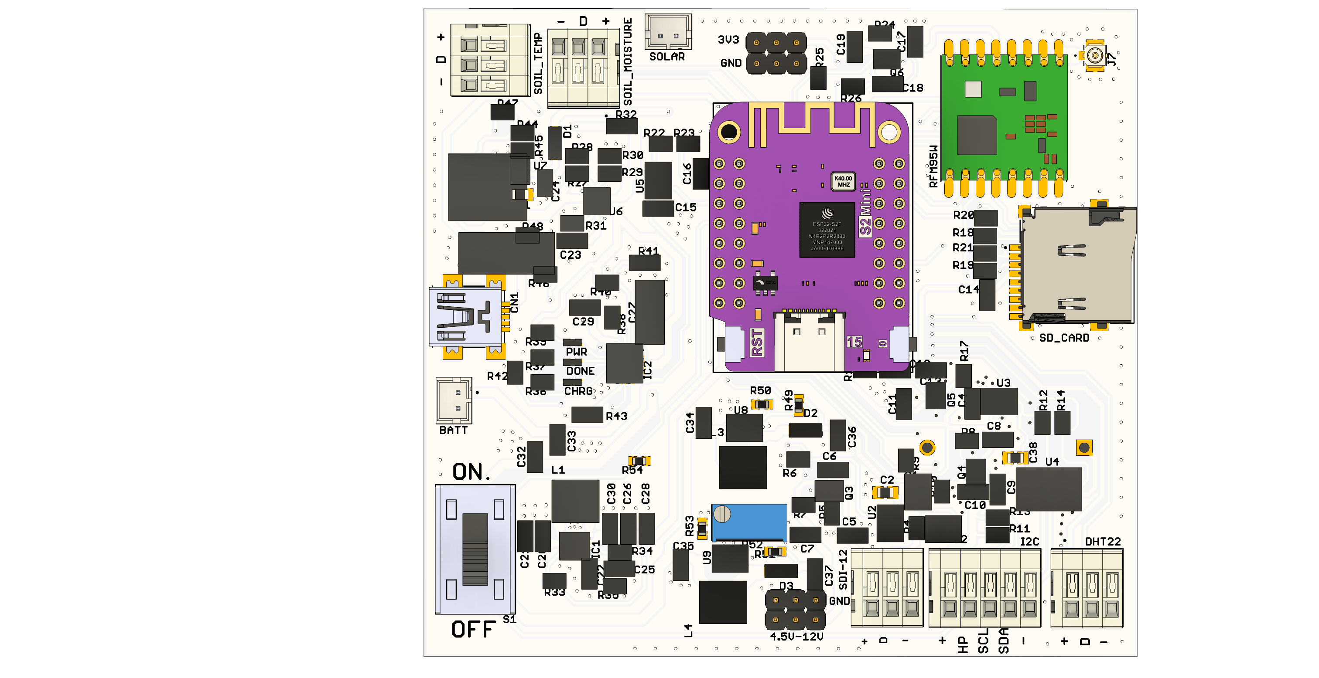
PORT 1
PORT 2
SOLAR
PWR 1
USB-IN
SD CARD
BATT
POWER SWITCH
PWR 2
PORT 3
PORT 4
PORT 5

